Slide 1
HOW TO SOURCE FROM ASIA
Main target audience: new buyers
Objective: To provide basic knowledge on key aspects of importing and practical “get started” information
Introduction
Notes:
Based on experience in China leveraging points from the book written by Mike on AQF’s board of directors.

Slide 2
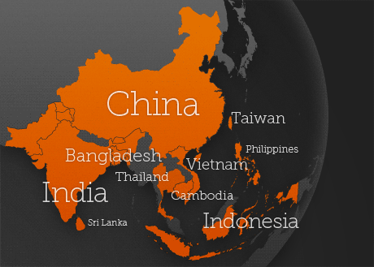
Asia Quality Focus
Product Inspection & Factory Audit Services (3PQC)
www.AsiaQualityFocus.com
Introduction

Slide 3
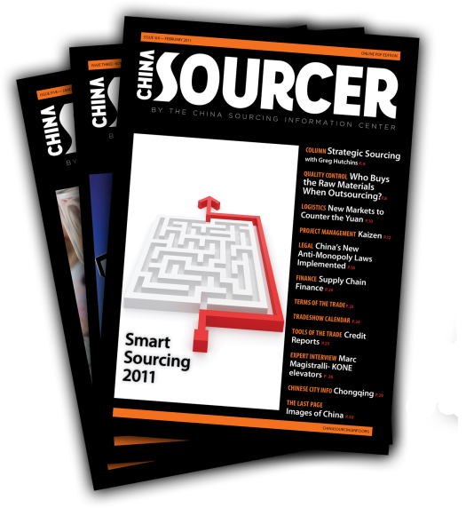
Intro to the CSIC
CSIC is a not-for-profit organization that exists to help educate, develop, and advance the China sourcing profession. The following resources are available free of charge to the public:
» Monthly updates on sourcing trends
» Video Tutorials
» Ask-the-Experts Service
» Buyer Blogs
» White Papers
» Endorsed Service Providers
NEW: SupplierBlacklist.com
Introduction

Slide 4
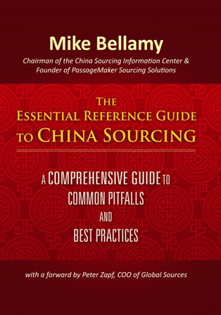
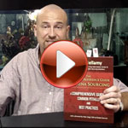
www.ChinaSourcingInfo.org/book
Includes templates for PO, Supplier Contract, Factory Audits, QC guidelines, RFQ and more.
Introduction

Slide 5
Rundown
  “Managing Asia sourcing expectations: opportunities and pitfalls”
    Knowing your product
    Knowing the sourcing destinations
    Knowing what types of factory you desire
    Knowing how to find Factories
  “Qualifying suppliers & communications”
    Ensuring Quality production and safe suppliers
    Ensuring fruitful and safe negotiation and payment terms
  5 Common Mistakes
  Q&A
Introduction

Slide 6
What you need to think about…
What product?
How to procure this product?
Where to procure this product?
How to ensure quality production?
How to ensure you are not being scammed?
What kind of agreement to sign?
How to pay your supplier?
How will you ship your goods?
How will you warehouse?
Who will distribute?
What are the applicable import duties?
What are the regulations?
Etc.
Introduction

Slide 7
What you don’t need to think (too much) about…
No need to spend a lot of time on cultural differences
Generally speaking, open to international business practices, your cultural understanding is not a pre-requisite.
Business First
Little language goes a long way
Very forgiving of cultural mistakes
…But there are a few things to be aware of in terms of types of suppliers, QC etc
Introduction

Slide 8
What product?
Have a plan
KNOW your product
  Practical to import?
  Easily designed/ explained to a factory?
Know regulations in your country
Know testing requirements
Be the Expert!
  Reliance on factory
  Research
Introduction

Slide 9

Where to procure this product?
Finding a Source
Notes:
Many regions, Different Specialties? Accessibility?
Know where to source from/ what kind of factory you’re looking for.

Slide 10
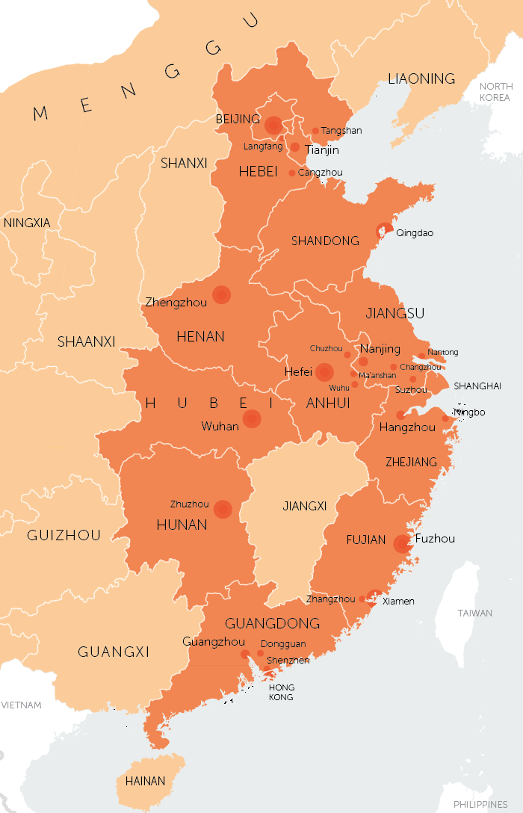
China & Taiwan
Pearl River Delta: Hong Kong, Shenzhen, Guangzhou, Dongguan
Yangtze River: Shanghai, Jiangsu Zhejiang
Northern China: Beijing, Tianjin, Qingdao
Taiwan: Taipei, Tainan
Pros:
  “One stop sourcing”
  Manufacturing experience
  Access to capital
  Established infrastructure: logistics and legal
Cons:
  IP concerns
  Short-term transaction mindset
  Quality Control
  Rising Prices
    Lower quality, False materials, etc.
The next china???.....
Finding a Source

Slide 11
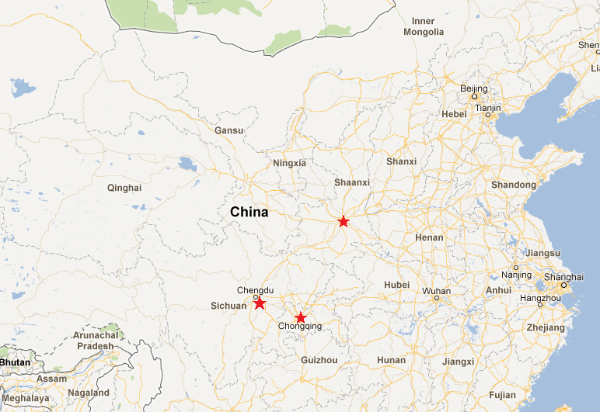
…Western China
Chengdu, Chongqing, Xian
  Samsung and Foxconn
But… beware of: Higher taxes, Higher logistics prices, Employee skillset?
Finding a Source

Slide 12
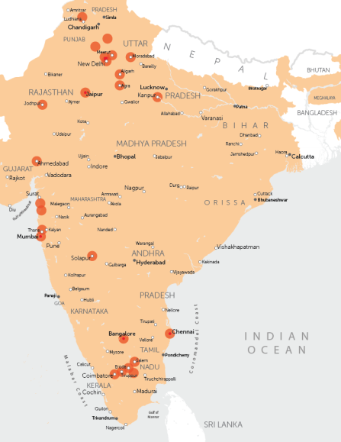
India
India: Textiles, Metalware, Jewelry
  Pros: Understanding of Western business/ culture, Understand long term relationships, English speaking
  Cons: Logistics, Tariffs, Productivity? Cost of labor/benefits
Finding a Source

Slide 13
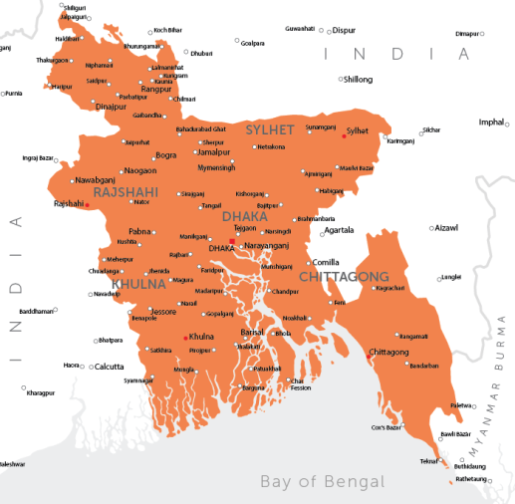
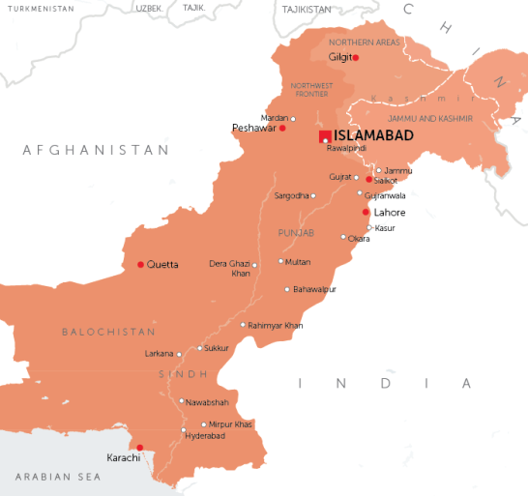
Bangladesh & Pakistan
Bangladesh: Textiles
  Pros: Lower Pricing, Established industry, Lower MOQ
  Cons: Quality, Social issues, slow on lead-times
Pakistan: Textiles
  Pros: Pricing
  Cons: Security
Finding a Source

Slide 14
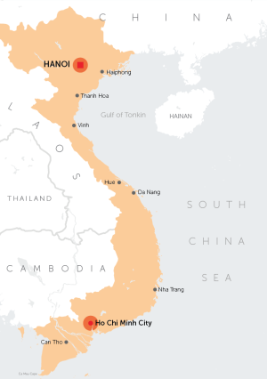
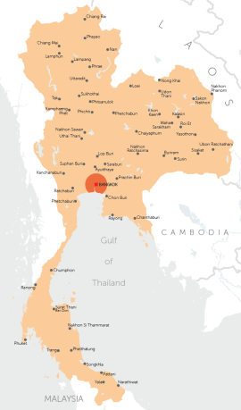
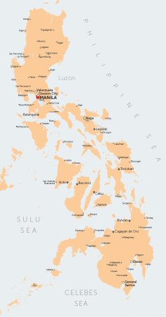
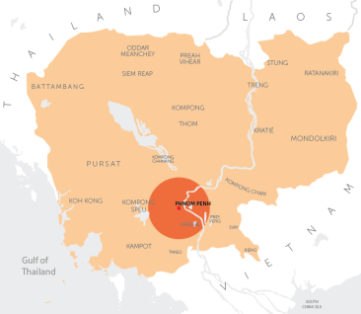
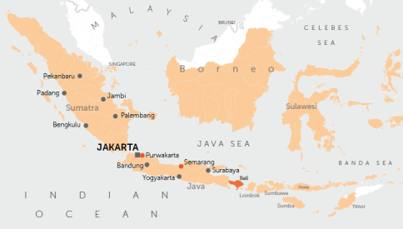
Southeast Asia
Vietnam
Thailand
Cambodia
Indonesia
Philippines
Shoes, garments
Pros: Low-wage workforce, Pricing, Physical distance from Australia
Cons: Lead times, regulatory hurdles, corruption, high transportation costs, lack of skilled workers
Finding a Source

Slide 15
What kinds of factories?
Pros & Cons
    “Asian Owned, Asian based” factory
    “Foreign Invested Enterprise” Asian factory
    Wholly Owned Foreign Enterprise
    Joint Venture (or fabricated venture?)
    State Owned Enterprise
Finding a Source

Slide 16
How to find a supplier?
Finding a Source

Slide 17
Trade shows
Australian International Sourcing Fair
Global Sources (HK)
Canton Fair (Guangzhou)
MEGA Show (HK)
HKTDC (HK)
Finding a Source

Slide 18
Trade show tip:
Prepare supplier checklist
Who is the factory’s owner?
How old is the factory?
What kind of products do they make?
Which markets do they cover?
Who are the actual clients?
What percentage are exported?
What is their production capacity?
How many employees?
How often do they subcontract?
What is the Minimum Order Quantity (MOQ)
Finding a Source

Slide 19
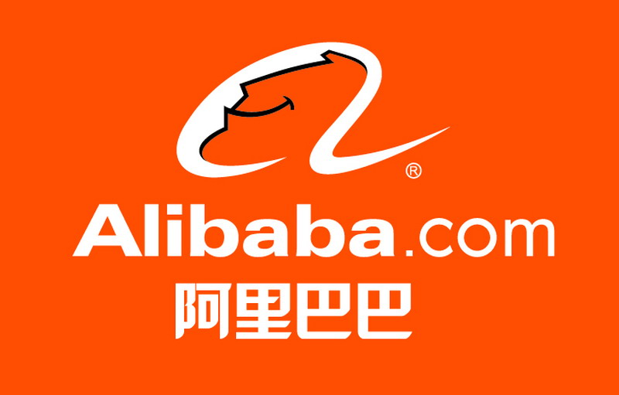

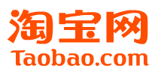
Online?
Alibaba: 2 Million suppliers
Global Sources
Taobao
MFG.com, Globial, Et al
Finding a Source

Slide 20
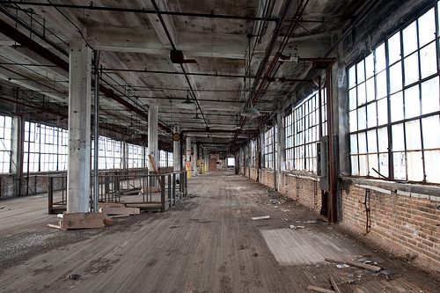
Risks
Legitimate supplier?
Scammer?
Finding a Source

Slide 21
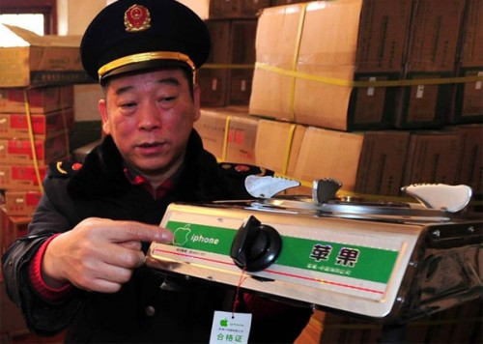
Risks
Quality?
Genuine products?
Finding a Source

Slide 22
Trading Companies and Middlemen
Factory Direct or Not? (Good vs. bad trading companies & middlemen)
    Costs
    Quality
    Plan for IP
    Project Management
    Communications
Finding a Source

Slide 23
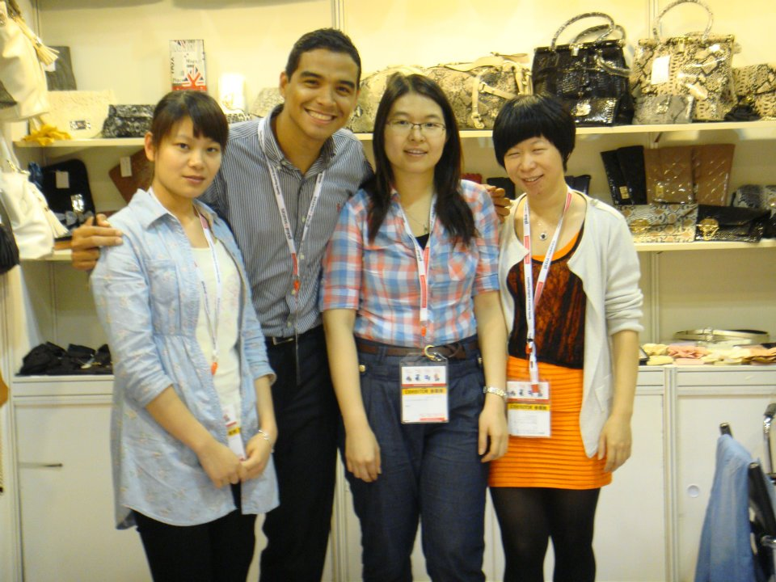
Hand bags? Car parts? Computers?
Finding a Source
Notes:
Middleman @ trade show story.

Slide 24
How to qualify a supplier?
Finding a Source

Slide 25
QC Essentials
FREE Tools
1. Does your factory have a Quality Manual?
“PQM” template available at www.PSSchina.com
2. Ask for references
INEXPENSIVE Tools
1. Factory Audit
Few 100 USD if using a 3rd party specialist like www.AsiaQualityFocus.com
2. Consider verification & investigation by specialist like www.CBIconsulting.com.cn
Verifying a Source

Slide 26
Factory Audit
Reputable?
Capable?
  ALL kinds of factories
  Adequate Work force?
Who they say they are?
  Scammer?
  Middleman?
Avoiding scams and inexperienced vendors
Compare potential vendors and select a viable source
Check the needed certificates and licenses for the specific factories
Check the experience of the factory in manufacturing targeted products
Get the full view of the factory structure, its organization, quality process and experience
Verifying a Source

Slide 27
Product Inspections
When?
  At any point in production
  Normally done in early stages + upon completion
What?
  Product appearance (AQL) & Workmanship
  Safety and functionality
  Quantity, assortment
  Colors/ measurements/ weight
  Labeling & logos
  Packing & packaging
  Special requirements you may have.
Why?
  Ensure that the mass production quality is the same as your specs & sample.
  Implement necessary corrective actions before having too many defects
  Be aware of the percentage of defects of finished products
Verifying a Source

Slide 28
QC Fundamentals
As we advance from Concept to Production to Delivery, the cost associated with testing and fixing any problems increase exponentially.
You will see that a few simple steps, early on, not only are inexpensive, but very effective in reducing the exposure to non-conforming products.
Verifying a Source

Slide 29
General Negotiation Tips
Orient yourself toward the decision maker
Using a translator (slow down, prep terms, bring your own)
Keep supplier at Arms Length
Relax
Negotiating Price
Don’t rely on your negotiation skills.
Do rely on your research skills.
Negotiations

Slide 30
Contracts and Payment
    Suggestions about Payments & Financial Risk
  Make a road map for better terms
  “30-40-30”
  Letter of Credit
  Financial Exposure is really Quality Exposure
  If worried about Traditional Risk then consider:
    - Site visits by you or a 3rd party to confirm vendor is a real manufacturer
Negotiations

Slide 31
5 Common Mistakes that importers make?
Common Mistakes

Slide 32
Mistake #1: Poorly defined specs
Very dangerous if your product is customized
What can go wrong?
  DFM becomes “DFS”. Price/Quality/Lead time compromised
  Lose control over IP
Solution: Manufacturing & Engineering are stand alone services.
Common Mistakes

Slide 33
Mistake #2: Not knowing the all-in cost of the “Asia price”
Often overlooked costs in addition to the purchase price:
            Investment into tooling
            Insurance for tooling
            Shipping and logistics
            Quality Control
            Exchange rate volatility
            Emergency visits to Asia
            Claim handling
            Commissions to agent
            Factory Audits
            Privately owned equipment AUD to RMB/INR/etc.
            against fire, damage etc. Last minute flight tickets and accommodation
            8%
            10%
Common Mistakes
Notes:
Private owned tools (OEM items)
- with OEM (original equipped manufacturer’s) items, meaning the tools belong to the foreign enterprise
and NOT to the producing Chinese factory
Tooling insurance
- will have to insure your own tooling against theft, damages, etc.
Shipping and logistics: up to 8-10%:
- freight insurance
- local charges China
- customs duties
- warehousing
- pick up costs
- delivery costs
Quality Control: up to 10%
- product inspection
- in-line inspection
- final inspection
- lab testing arrangement and certificates
Emergency visits to China:
- flight costs to China,
- accommodation
Exchange rate:
- RMB to USD conversion loss
Claims
- rejection of shipment by customer
- return of goods
- penalty payments

Slide 34
Mistake #3: Failure to audit the factory/ Falling for the golden sample
Dangers of not auditing the factory
What a golden sample does not guarantee
An idea about QC services pricing
Common Mistakes

Slide 35
Mistake #4: Payment terms not linked to performance of supplier
  Keep the deposit as small as possible and don't make the remaining payments until after the 3rd party has done the inspection
  30/70 or no deal
  30/40/30 is better
Common Mistakes

Slide 36
Mistake #5: Registering your intellectual property (IP) after you have been knocked off
  Pay the limited expenses, engage a lawyer to register trademarks prior to doing any business in Asia, especially in China
  “First to register” vs. “First to use”
  “Squatters”
Common Mistakes

Slide 37
  Asia Quality Focus
  Email: Dave@AsiaQualityFocus.com
  Company: www.AsiaQualityFocus.com
  China Sourcing Information Center
  (A Not for Profit, Buyer Support Network/Endorsed Service Providers at www.ChinaSourcingInfo.org)
  Twitter: @QualityFocus
  LinkedIn “David B. Fisher”
  or stop by booth I26 to visit
Let’s thank the Australian International Sourcing Fair
Most suppliers are a pleasure to deal with, but…
  Spend the time to find the right partners for both manufacturing and service providers
  Inspection linked to a Payment Plan

